Slide 1
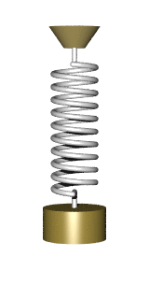

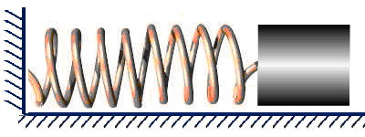
OSCILLATIONS
HARMONIC OSCILLATION
Author: Mariyana Avramova
Teacher of Physics and Astronomy
Dobri Chintulov Secondary School of
Natural Sciences and Mathematics
City of Sliven

Slide 2

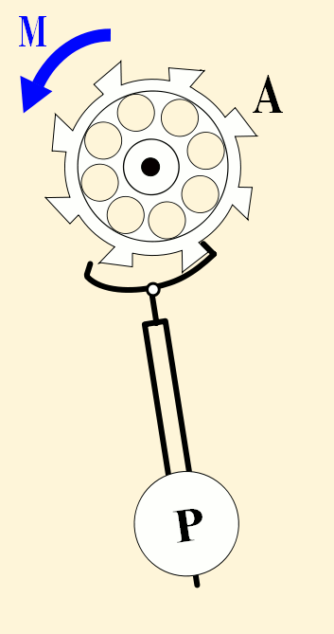

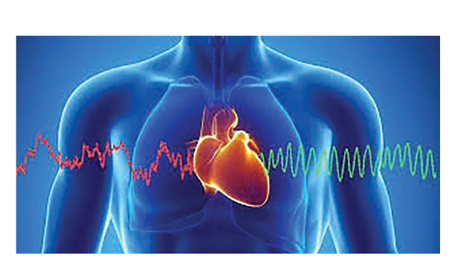
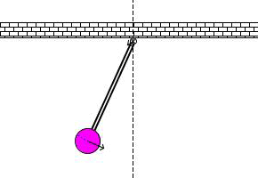

Slide 3


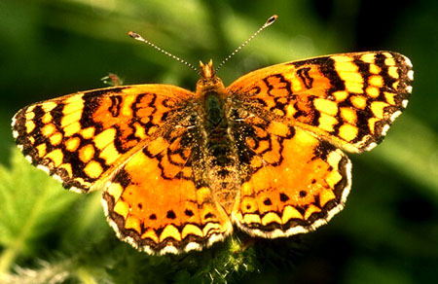


Slide 4
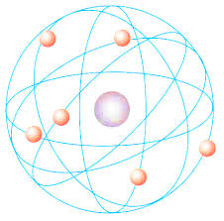

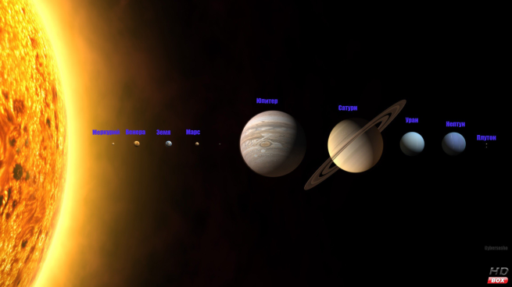

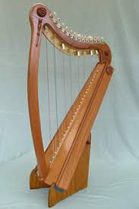
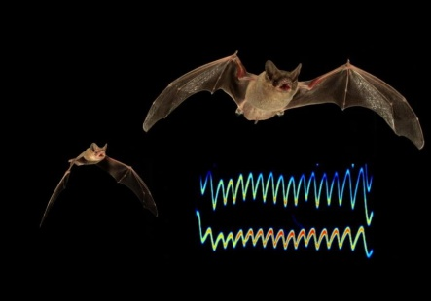

Slide 5





Slide 6
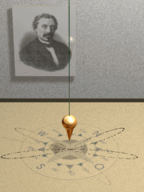
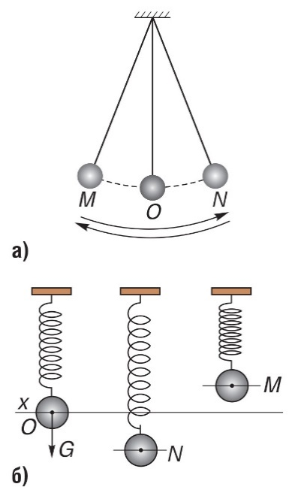
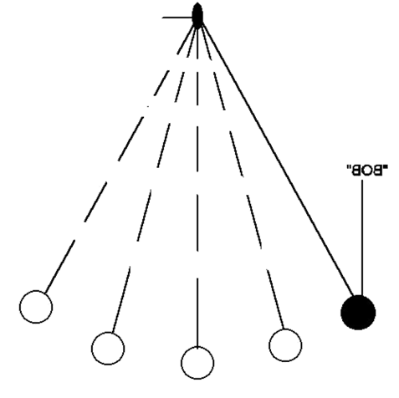
Oscillation
Equilibrium position – position in which an object is motionless and which it takes again after its motion ceases.
b) Definition of oscillation – periodic motion in which an object moves repeatedly at a distance about its equilibrium position.

Slide 7
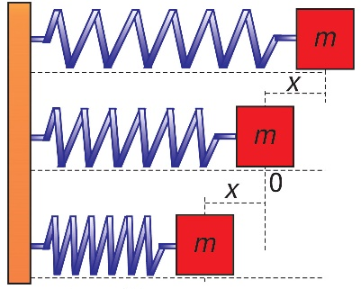
2. Oscillation characteristics:
а) Displacement:
Definition: Distance х from the equilibrium position of an object to the position in which the object is at a certain time;
Symbol: х;
Unit of measure: m, (metre);
x
N t(2)
Q (tn)
O
P (t1)

Slide 8
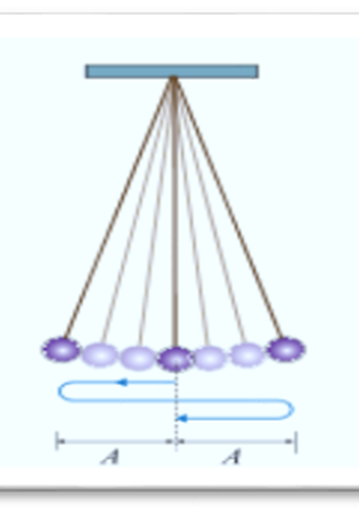
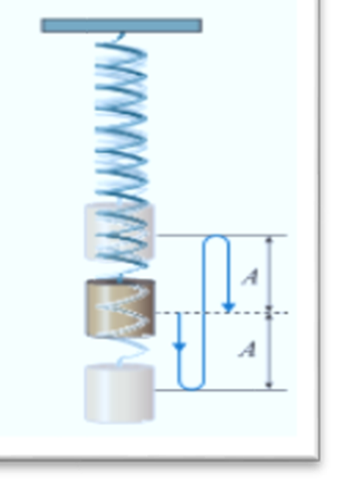
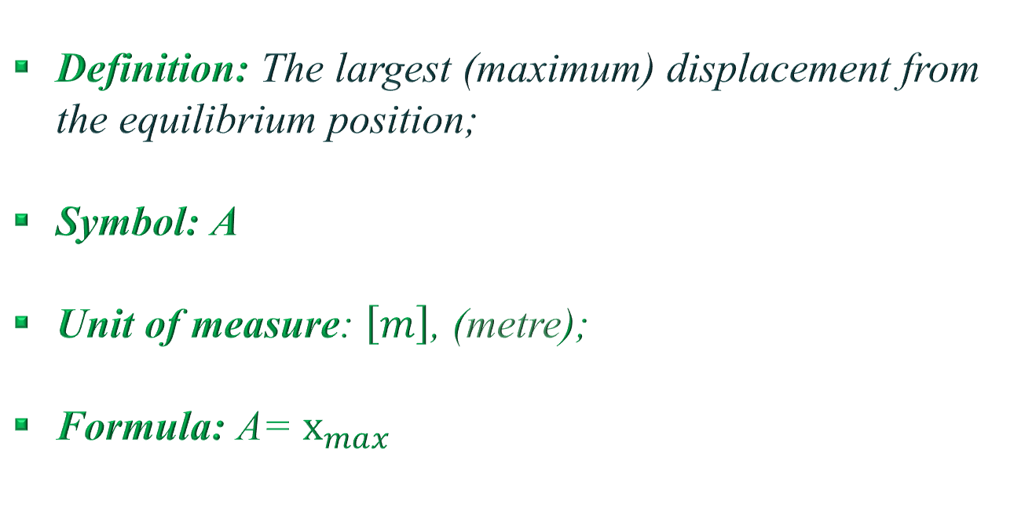
b) Oscillation amplitude;
Definition: The largest (maximum) displacement from the equilibrium position;
Symbol: А
Unit of measure: $\left[m\right]$, (metre);
Formula: А= $х_{max}$

Slide 9
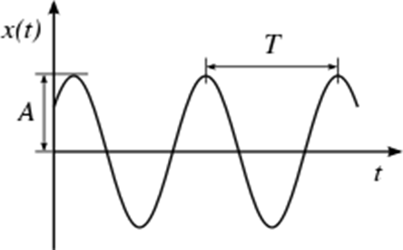
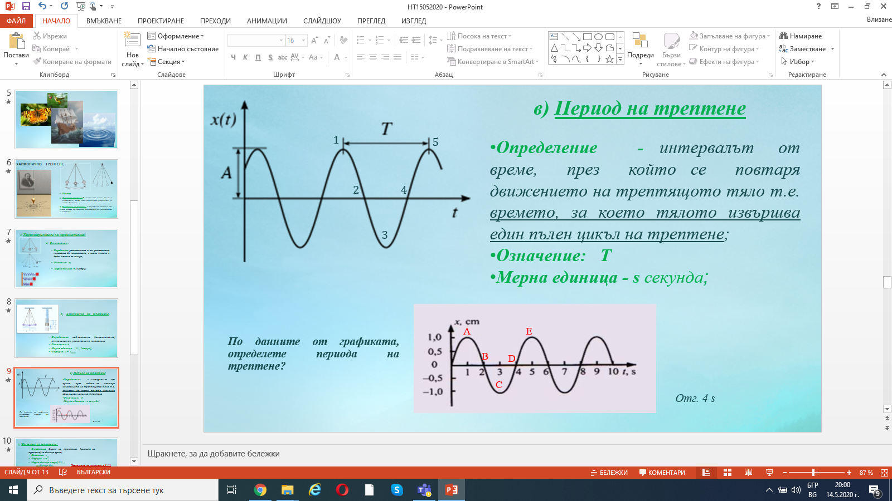


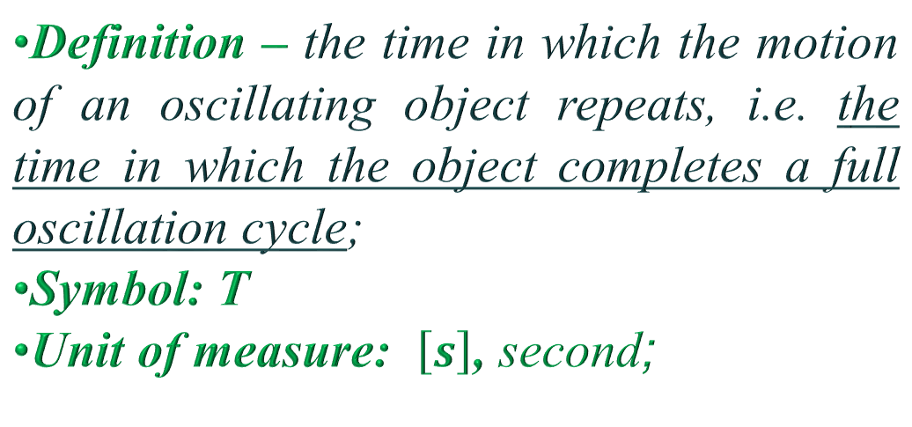



c) Oscillation period
$$1$$
$$5$$
Definition – the time in which the motion of an oscillating object repeats, i.e. the time in which the object completes a full oscillation cycle;
Symbol: Т
Unit of measure: $\left[s\right]$, second;
$$2$$
$$4$$
$$3$$
Solve the problem:
Determine the period of oscillation using information from the graph.
Answer: 4 s

Slide 10
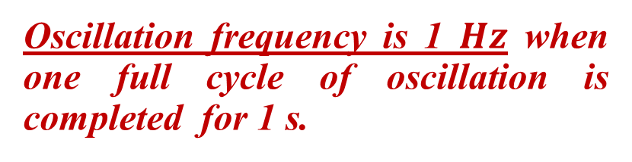
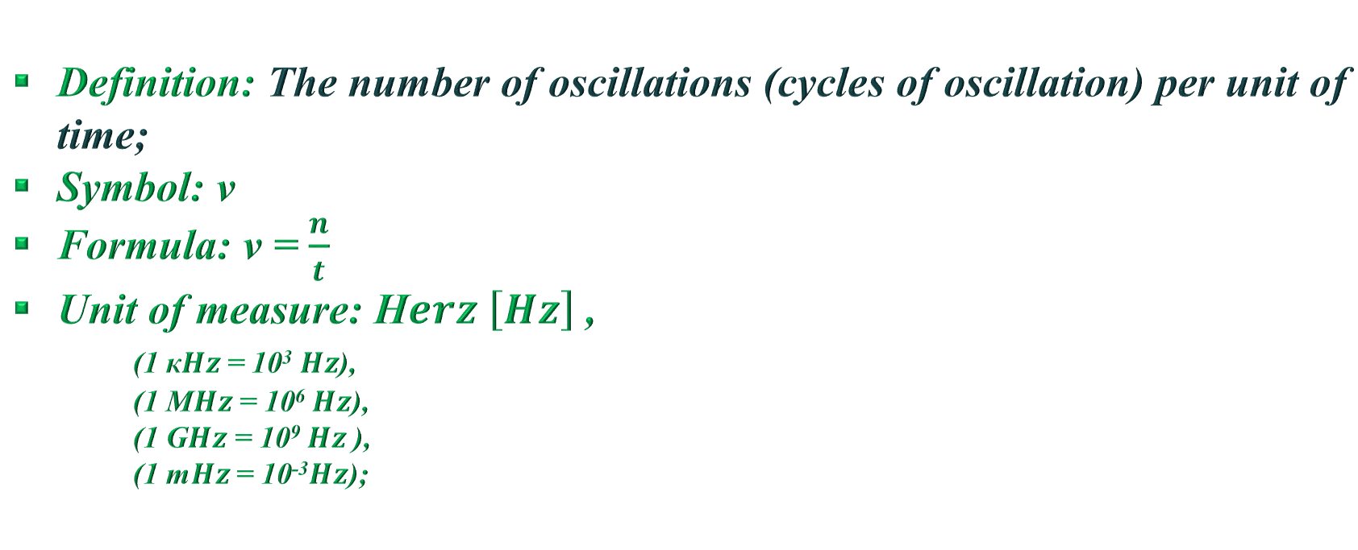

d) Oscillation frequency:
Definition: The number of oscillations (cycles of oscillation) per unit of time;
Symbol: ν
Formula: ν = $\frac{n}{t}$
Unit of measure: H$erz \left[Hz\right]$ ,
(1 к$Hz$= 10³$Hz$),
(1 М$Hz$ = 10⁶$Hz$),
(1 G$Hz$ = 10⁹$Hz$ ),
(1 m$Hz$ = 10⁻³$Hz$);
Oscillation frequency is 1 $Hz$ when one full cycle of oscillation is completed for 1 s.
e) Relations among the main oscillation characteristics:
Т = $\frac{1}{ν}$ ν = $\frac{1}{Т}$

Slide 11
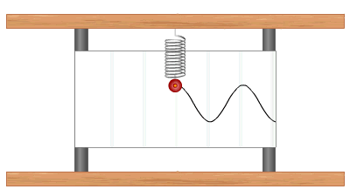
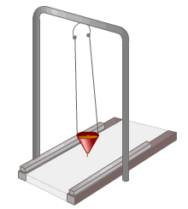
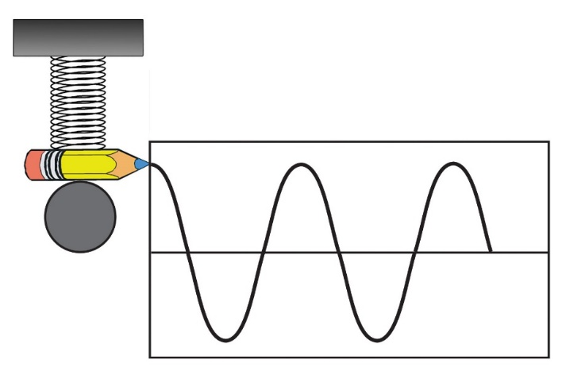
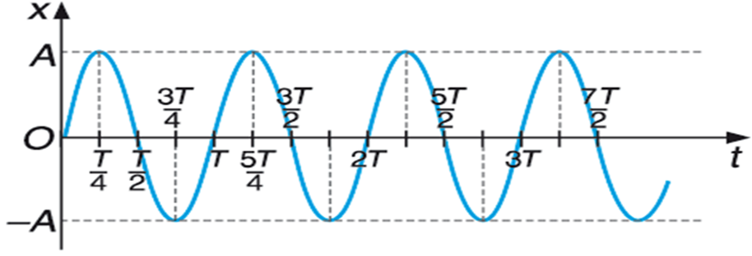
3. Harmonic oscillation
а) Definition: Any oscillation in which the displacement х of an object from its equilibrium position, in the course of time t, can be represented graphically by a line called a sinusoid.
b) Analysis of the graph of
harmonic oscillation
Graph section: from time t=0 to time t = Т/4;
Graph section: from time t = Т/4 to t = Т/2;
Graph section: from time t = Т/2 to t = 3/4 Т;
Graph section: from time t = 3/4 Т to t = Т;

Slide 12

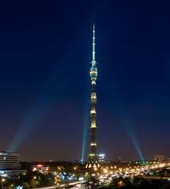
The small size of the humming bird and its ability to maintain constant body temperature require intensive metabolism. Its heart makes up to 1260 beats per minute, i.e. the frequency of its vibrations υ is 21 Hz.
The amplitude of oscillation А of the top of the Ostankino tower in Moscow, 540 m high, is 2.5 metres during high winds.

Slide 13
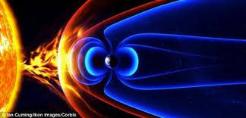
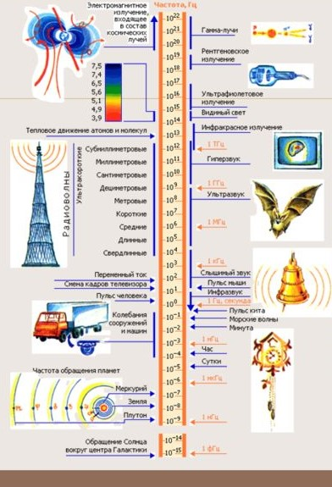





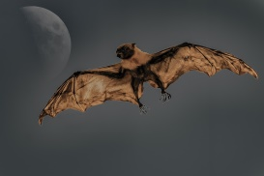


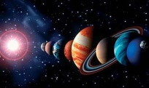
Frequency Hz
Electromagnetic emissions, included in the composition of cosmic rays
Gamma rays
Oscillations can be mechanical, electromagnetic, chemical, thermodynamic and many other, but regardless of their great diversity, they all have common characteristics!
X-ray
Ultraviolet emission
Thermal motion of atoms and molecules
Infrared emission
Radio waves
Ultrasound
TV frame rate
Audible sounds
Human pulse rate
Sea waves
Oscillations of machines and equipment
Planet rotation
Mercury
Earth
Pluto
Rotation of the Sun around the centre of the Galaxy

